Slide 1
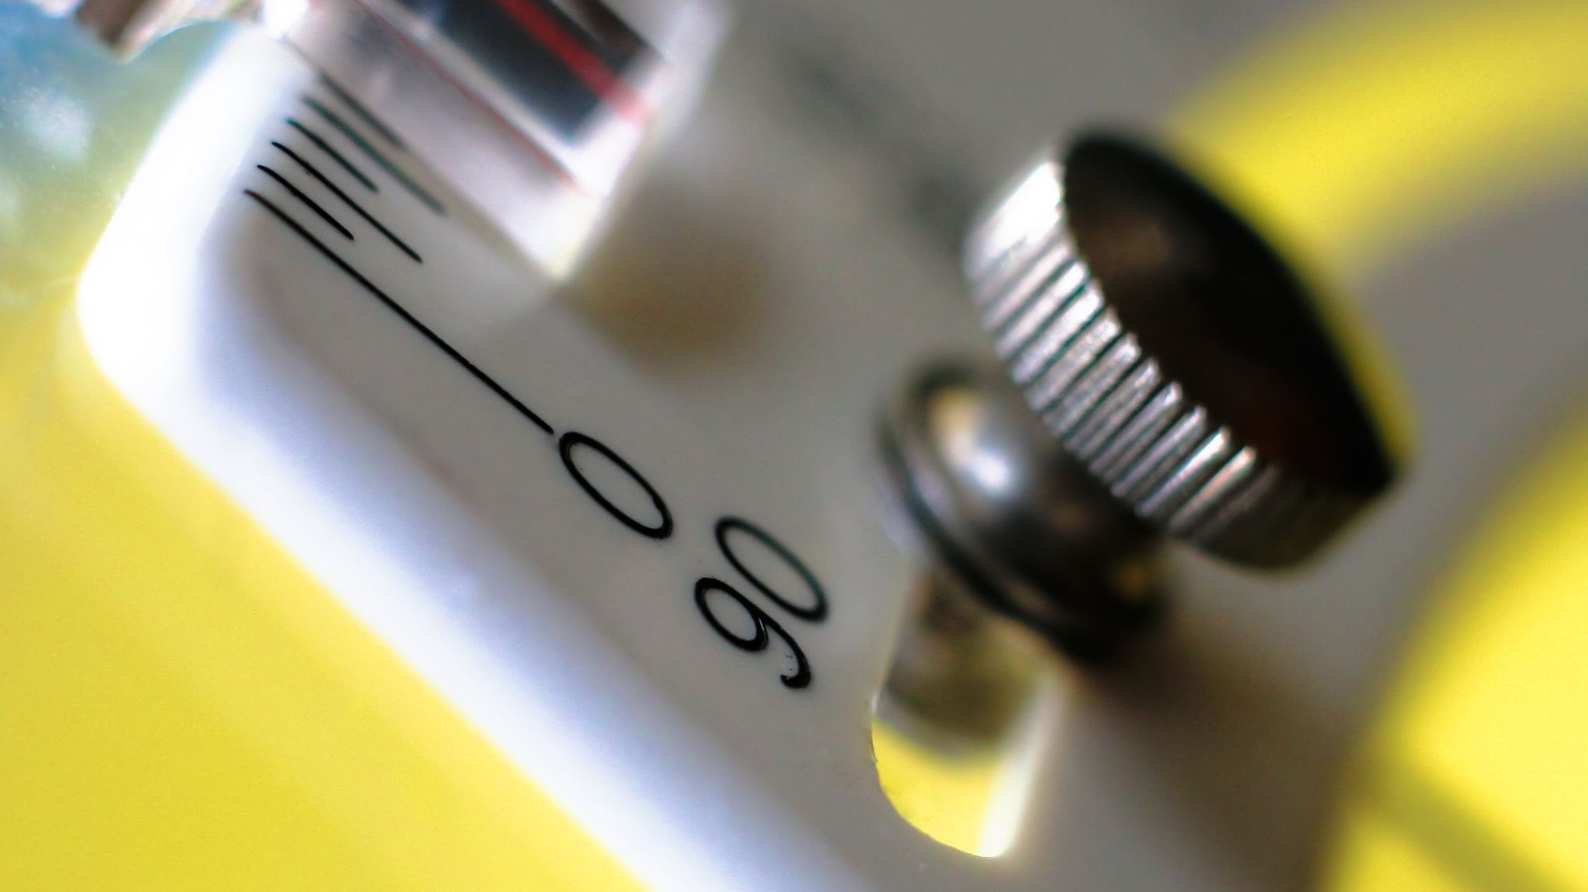
LPG GAS SENSING, CONTROL AND ALERT
INTRODUCTION TO INTERNET OF THINGS + LAB
CS1702
MINI PROJECT

Slide 2

AIM
To design and develop an Arduino-based system for LPG gas sensing, control, and alert, aimed at ensuring safety in residential and commercial environments.
The system will integrate gas sensors to detect
- LPG leaks
- implement control mechanisms to shut off gas supply in case of a leak
- provide timely alerts through visual and auditory signals to notify users, thus preventing potential hazards associated with LPG gas leaks.

Slide 3
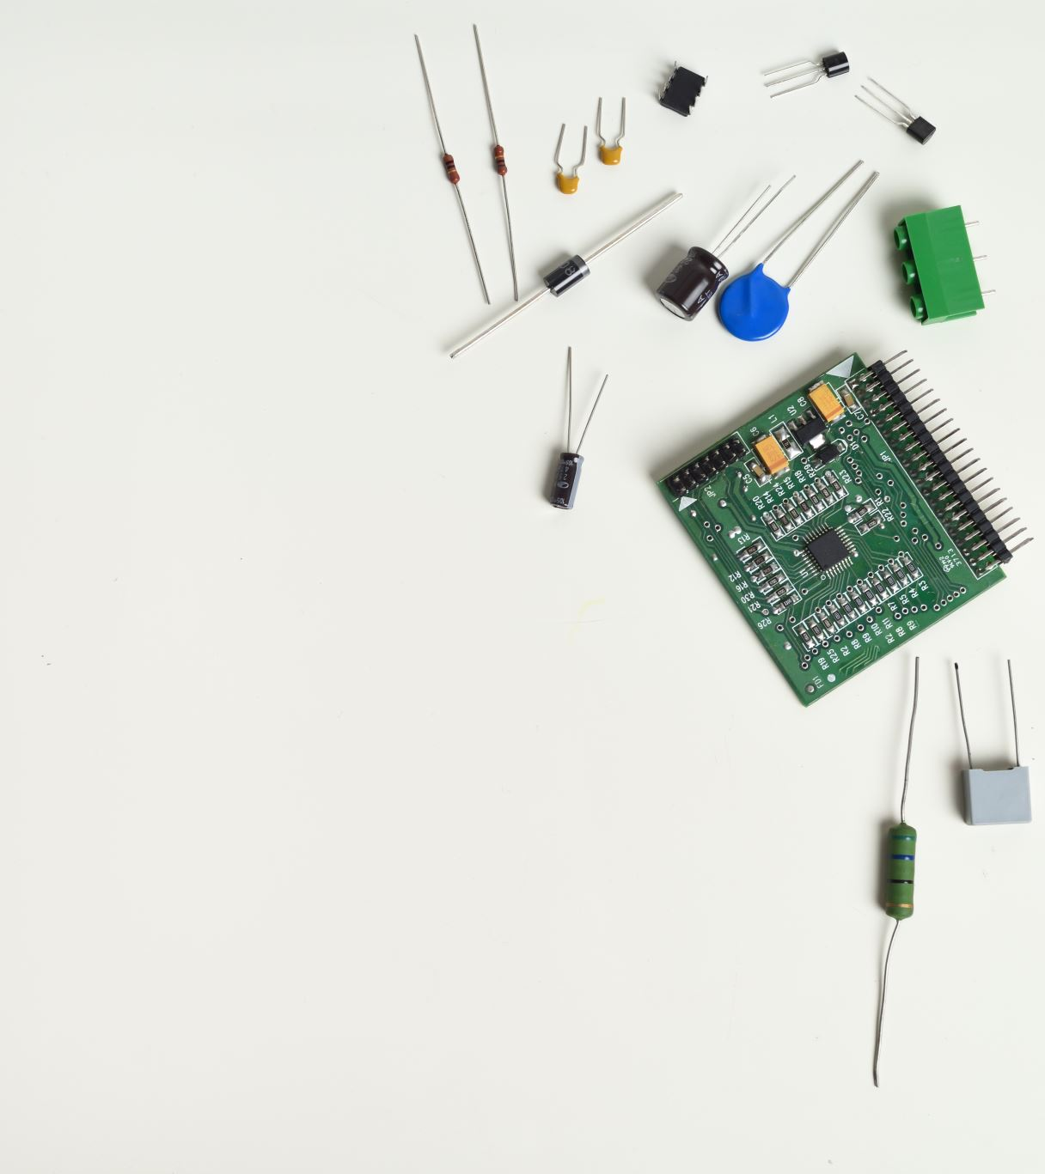
COMPONENTS REQUIRED
Arduino UNO Board
MQ5 Gas sensor
Servo motor
Buzzer
LEDs
Push buttons
Jumper wires
Bread board

Slide 4
KEY FEATURES
Real-time Monitoring: Continuous monitoring of gas levels using the MQ5 sensor.
Automatic Shutoff: Servo motor shuts off the gas supply upon detecting a leak.
Instant Alerts: Buzzer and LED provide audible and visual alerts in case of a gas leak.
Affordability: Utilizes low-cost components and open-source Arduino platform.

Slide 5
ARDUINO UNO CODE
#include <Servo.h>
const int buzzer = 7;
Servo myServo;const int sensorPin = A0
int sensorValue = 0;
const int buttonPin = 2
const int ledPin = 13int buttonState = 0;
int lastButtonState = 0;
bool ledState = false;
bool systemActive = false;
void setup() {pinMode(buttonPin, INPUT); pinMode(ledPin, OUTPUT);
pinMode(buttonPin, INPUT_PULLUP); pinMode(buzzer, OUTPUT);
Serial.begin(9600);
myServo.attach(9);}
void loop() {
//myServo.write(0);
sensorValue = analogRead(sensorPin);
Serial.print("Sensor Value: "); Serial.println(sensorValue);
delay(1000);
buttonState = digitalRead(buttonPin);
if (buttonState != lastButtonState) {
if (buttonState == LOW) {
systemActive = !systemActive;
if (systemActive) {
if (sensorValue<114){
digitalWrite(ledPin, HIGH);
delay(1000);
tone(buzzer, 4000);
delay(1000);
myServo.write(90);
delay(15);
//myServo.detach();
//noTone(buzzer); }
else {digitalWrite(ledPin, LOW);
noTone(buzzer); // Turn off the buzzer
myServo.write(0); // Move servo to initial position } //Serial.print(lastButtonState); } }
lastButtonState = buttonState;}

Slide 6
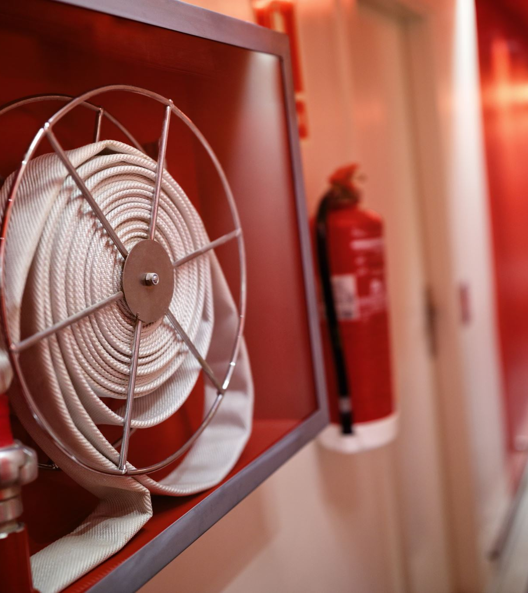
IMPACT
Enhances safety in homes, kitchens, and commercial spaces using LPG.
Affordable solution accessible to a wide range of users.
Potential to prevent accidents, injuries, and property damage caused by gas leaks.

Slide 7

FUTURE ENHANCEMENTS
Mobile app integration for remote monitoring.
Integration with smart home systems for automated responses.
Collaboration with gas suppliers for wider adoption.

Slide 8
THANK YOU TEAM MEMBERS 1.Joanna Cheryl C (23011102034) 2.M Harinee(23011102044) 3.P Jyoshitha Reddy (23011102060)

Slide 9
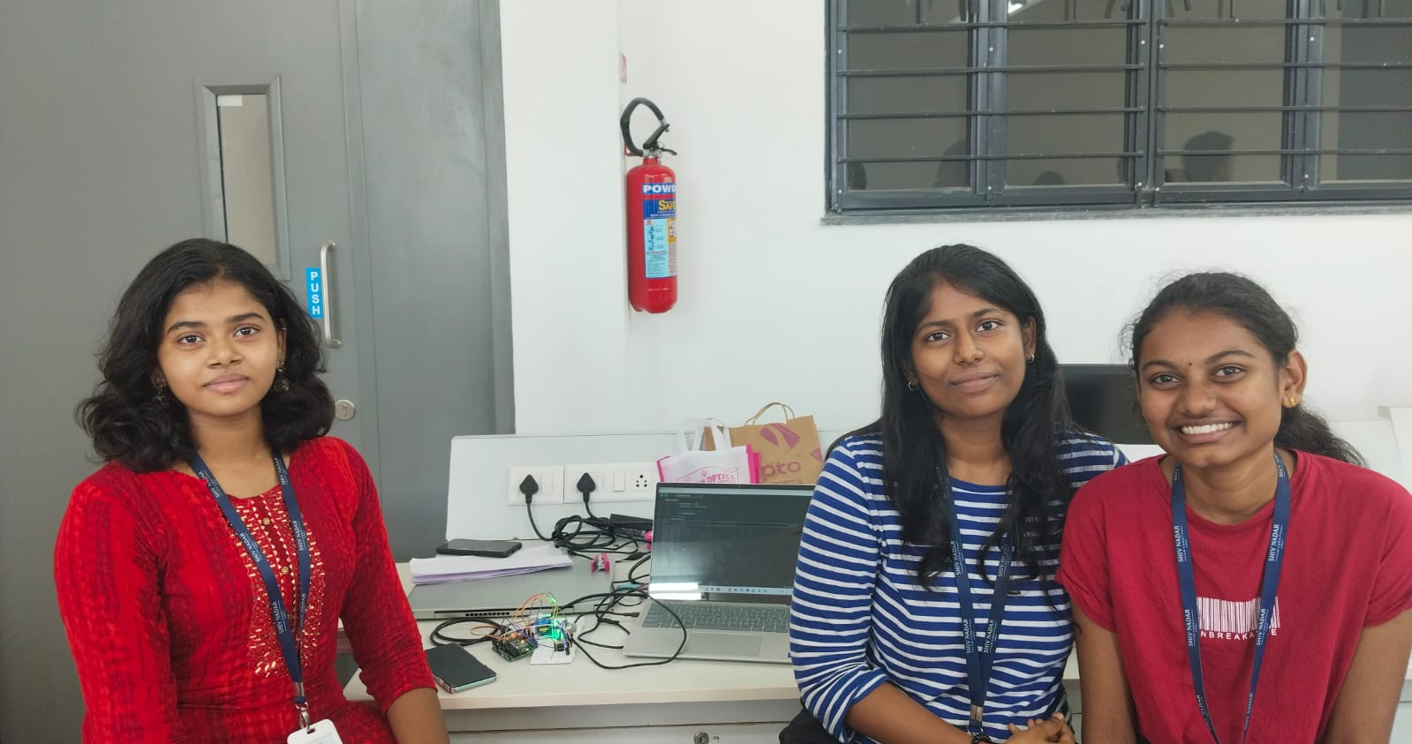
THANK YOU

